Slide 1







Green University of Bangladesh
Department Of Computer Science and Engineering(CSE)
Course Title: Algorithms
Course Code:CSE 205 Section: 221 D8
Presented by:
Md. Mahim Hossain
ID: 221902082
Presented to
Md. Abu Rumman Refat
Lecturer, Dept. of CSE
Green University Of Bangladesh

Slide 2



Table of Contents
Introduction
03
Activity Selection Problem
04
Problem & Solution
05
Conclusion
06

Slide 3



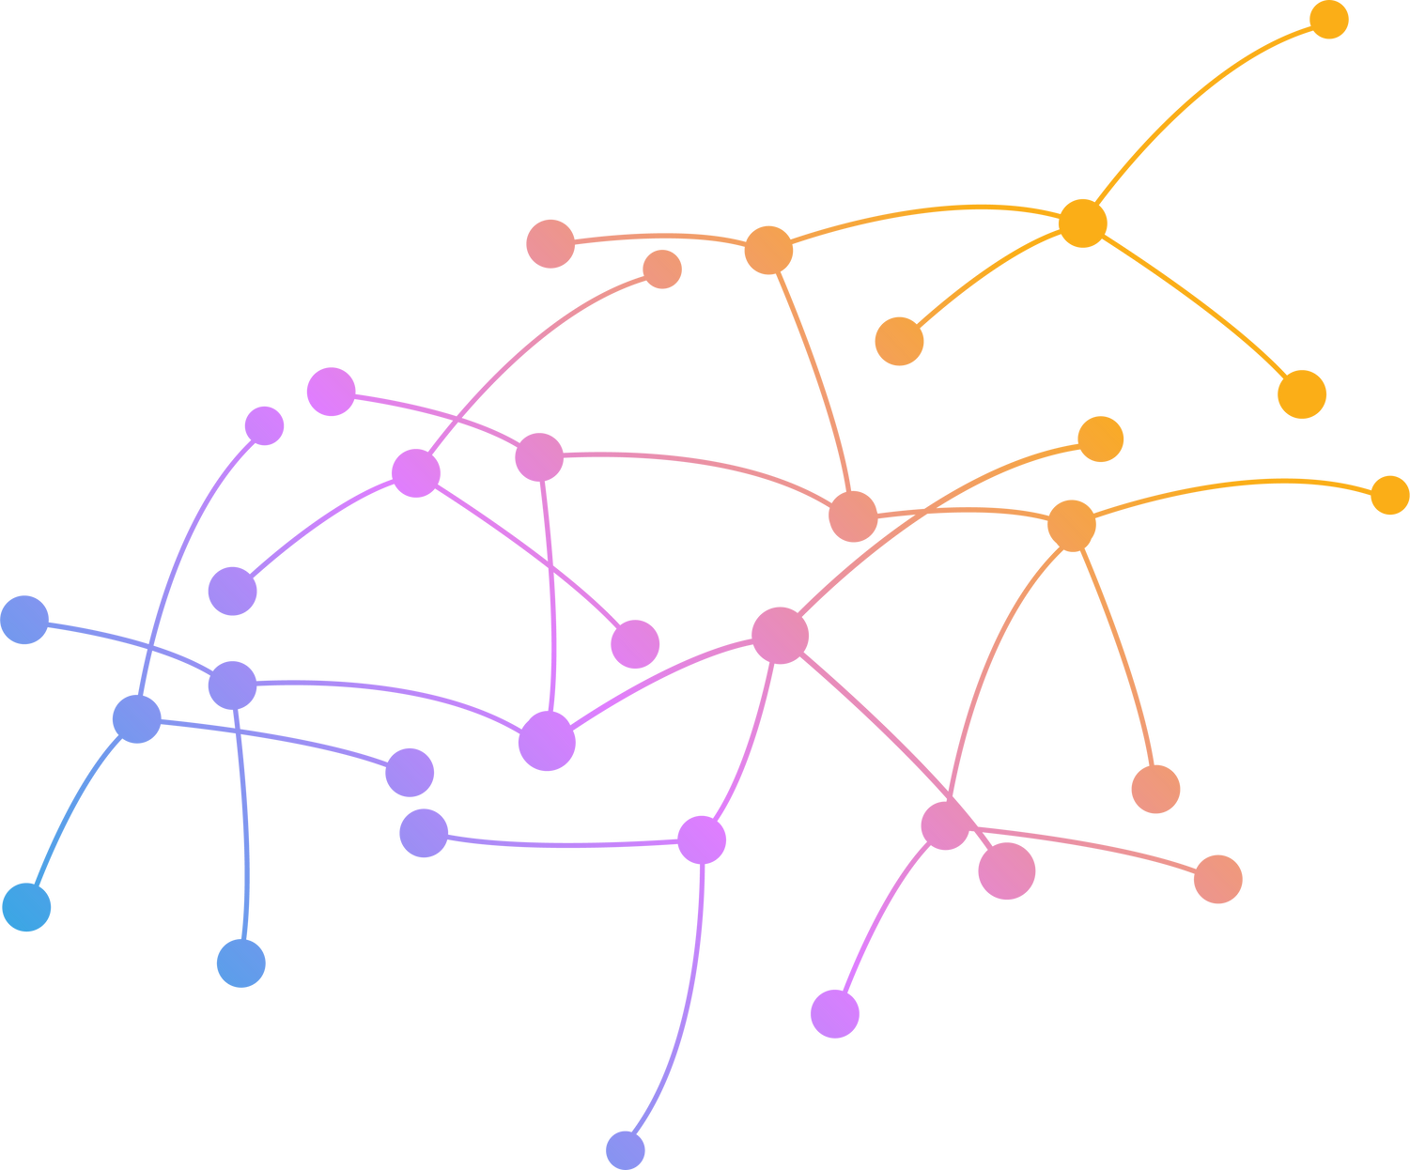

Introduction
The Greedy Approach for the Activity Selection Problem involves sorting activities by their finish times and iteratively selecting the non-overlapping activities with the earliest finish times. This strategy exploits the locally optimal choice of selecting the activity that finishes soonest, leading to a globally optimal solution.

Slide 4



Activity Selection Problem
What is Activity Selection Problem
The Activity Selection Problem involves maximizing non-overlapping activities within a timeframe. Solved through a greedy algorithm, it optimizes resource utilization in scheduling, finding applications in project management and job scheduling by selecting activities based on their finish times.
Why Activity Selection Problem
Resource Optimization: Maximizes non-overlapping activities for efficient resource use.
Greedy Algorithm Exemplar: Illustrates how the greedy approach achieves optimal solutions succinctly.

Slide 5


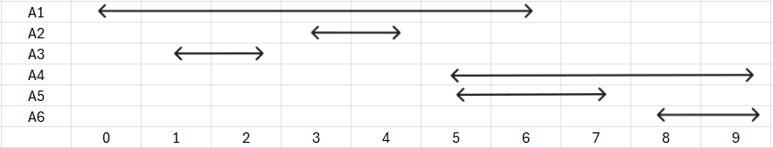
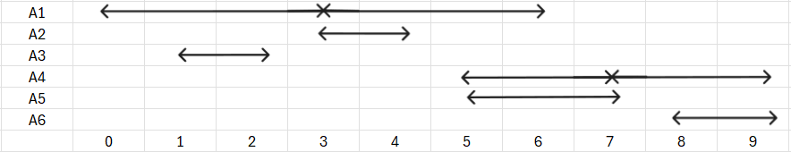
Problem & Solution
Problem:
What is the maximum number of activities that can be completed?
Activity | A1 | A2 | A3 | A4 | A5 | A6
Start | 0 | 3 | 1 | 5 | 5 | 8
Finish | 6 | 4 | 2 | 9 | 7 | 9
Solution:
Step 01:
Step 02:

Slide 6




Conclusion
The Activity Selection Problem, by efficiently optimizing resource utilization through a greedy algorithm, highlights the effectiveness of simple strategies in solving complex scheduling challenges, showcasing its practical relevance in diverse real-world scenarios.

Slide 7



Thanks for Watching
Md. Mahim Hossain
ID: 221902082
Contact
Any Question, Just Ask don't be shy
E-mail
faaiz.mahim@gmail.com
Phone
+880 18669-28533

